Slide 1


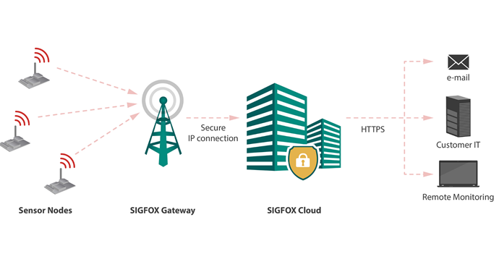



Baby on Board
Prevention of hot car deaths
Claire Cooney & Ellen Murphy
Laurel Hill Secondary School FCJ, South Circular Road, Limerick
References 1: https://www.babyalert.info/ 2 http://noheatstroke.org/

